Slide 1
Keypom 核心原理

Slide 2
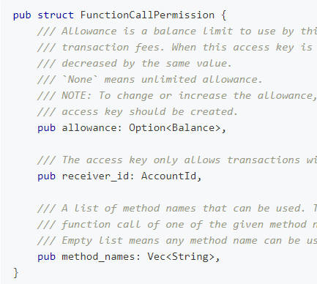
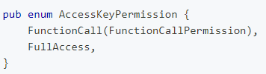
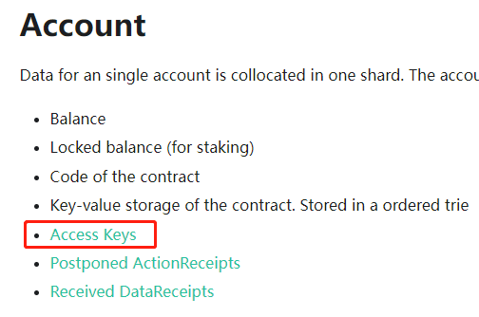
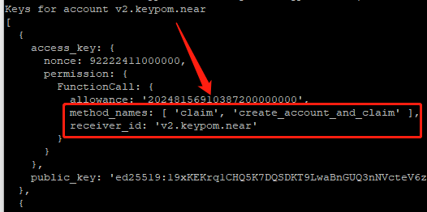
LAK
NEAR的账户与Key
Key: https://nomicon.io/DataStructures/AccessKey
Accoount: https://nomicon.io/DataStructures/Account
进一步限制FC Key

Slide 3
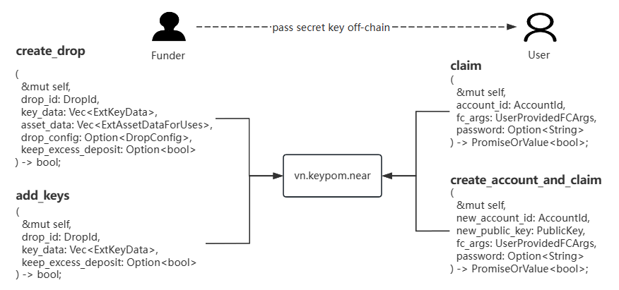
Key Interfaces
Core Smart Contract
keypom v1.4 v2 v3 https://github.com/keypom/
v2.keypom.near / v2.keypom.testnet

Slide 4
Keypom 用例逻辑分析

Slide 5
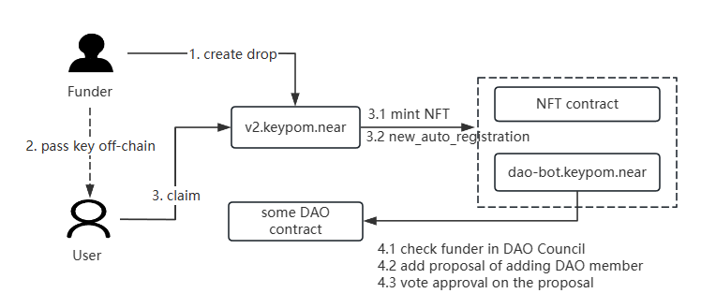
Auto-register DAO

Slide 6
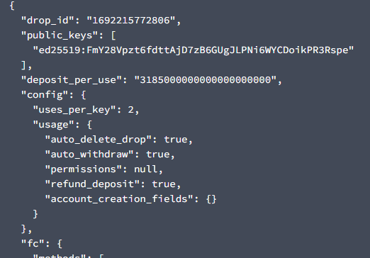
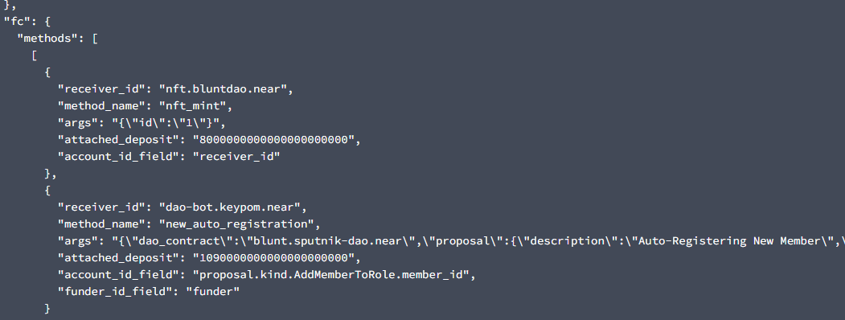
Auto-register DAO
Create Drop TX: FF4Ro9A4HZE1wZh7UZDNTScJQK1e2h88R12reFoFFn6s

Slide 7
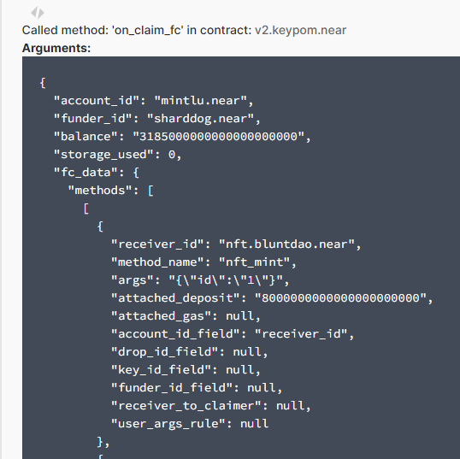
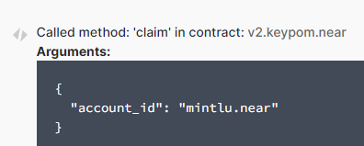
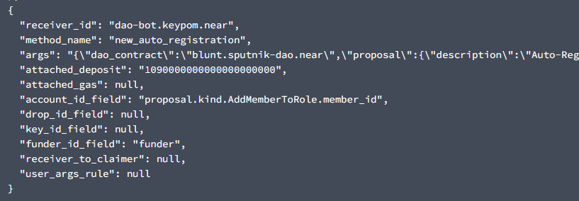
Auto-register DAO
Clam Drop TX: 2BokfpCkWpTwaTFJTwZWKv3bcMnGHAeR2Fzro6LuVPAA

Slide 8
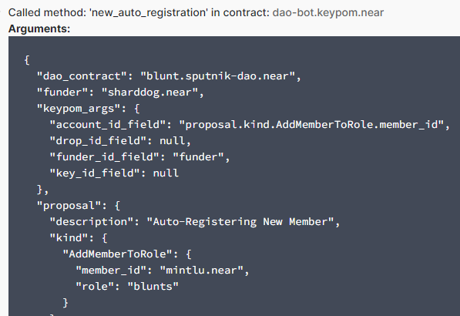

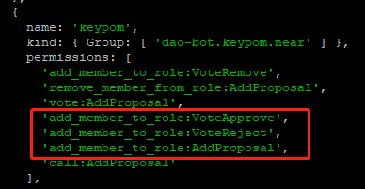
Auto-register DAO
dao-bot
actually add member

Slide 9
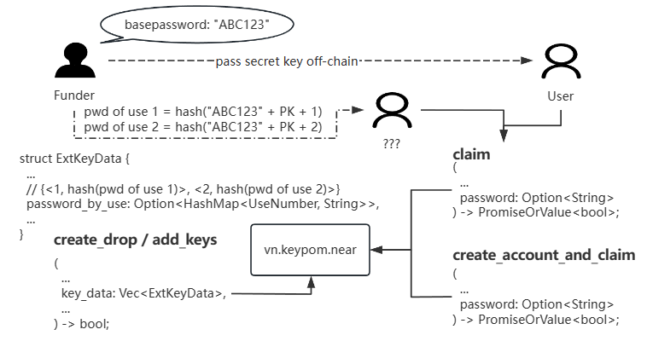
Password Protected Keys and POAP
Backend Logic One kind of conditional claim, i.e. password protected claim. password for a key: pwd = hash(base_password + PK) password for a key use: pwd = hash(base_password + PK + use_number) learn details here.
On Creating Drop Put hash(pwd) into contract
On Claiming Add pwd as additional argument

Slide 10
Password Protected Keys and POAP
POAP Usecase
For each key(ticket) in the drop: 2 uses, the first one has password, the second is normal.
User has sk, gateman has base password in his ticket checker dapp.
Ticket checker process is to calculate password of use 1 and do the 1st claim using the key.
POAP proof could be gained by user himself anytime afterward, as the keys 2ed use.
Could be extended to marketing and engagement events
Features
Tickets wont go valid until holders actually go to the event
No internet connection needed for users at event
Near wallet is not necessary for user to attend event

Slide 11
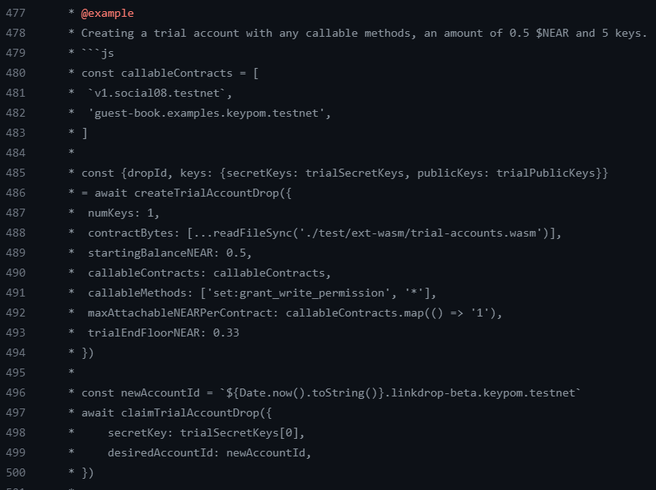
Trial Account
Combine On SDK Side
Organization side: createTrialAccountDrop(...)
User side: claimTrialAccountDrop(...)
see details on here.
Hints
Account created on claim
AA deployed on claim
limits defined by org

Slide 12
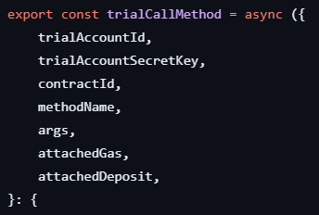
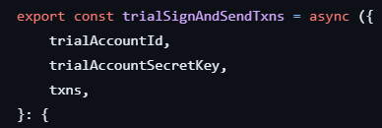
Use Trial Account
Trial Account Smart Contract
setup(): setup AA rules. (Beginning)
execute(): the proxy entrance for user. (Running)
create_account_and_claim(): convert trail to a regular account. (Ending)
repo is here.
SDK Support
trialSignAndSendTxns(...)
trialCallMethod(...)
see details on here.

Slide 13
NFT Access Key Ticketing

Slide 14
Useful References
https://keypom.xyz/
https://docs.keypom.xyz/
https://github.com/keypom

